Slide 1

Khatra Adibasi Mahavidyalaya
Department of Mathematics
Basics of Inequality
Session : 2020-2021
Programme : Mathematics (Hons) Semester : 1st
Paper: Algebra (C2)
Date of Delivery : 24 th August 2020
Prepared by:
Dr. Rima Barik

Slide 2
Definition and basic concepts :
When two real numbers are not equal, a relation of inequality is said
to exist between them.
The property of trichotomy :
Any two real numbers a, b must satisfy one and only one of the following relations:
a is equal to b (a = b),
a is greater than b (a > b),
a is less than b (a< b).

Slide 3
Basic Properties :
The followings are easily comprehendible properties of real numbers:
If a, b, c be real numbers, then
a > b and b > c implies a > c,
a > b implies a+c > b+c,
a > b and c > 0 then ac > bc,
a > b and c < 0 then ac < bc.
a > b and c = 0 then ac = bc.

Slide 4
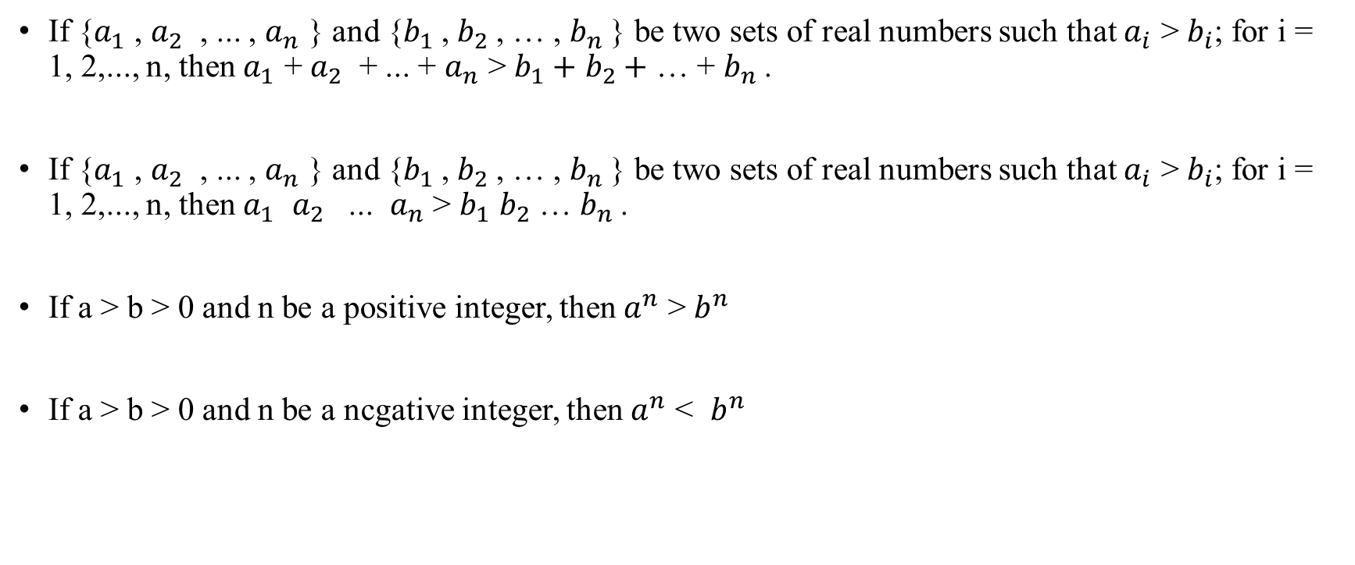
Some preliminary results :
If {$a_{1}$ , $a_{2}$ , ... , $a_{n}$ } and {$b_{1}$, $b_{2}$, … , $b_{n}$} be two sets of real numbers such that $a_{i}$ > $b_{i}$; for i = 1, 2,..., n, then $a_{1}$ + $a_{2}$ + ... + $a_{n}$ > $b_{1}+$ $b_{2}+$ … + $b_{n}$.
If {$a_{1}$ , $a_{2}$ , ... , $a_{n}$ } and {$b_{1}$, $b_{2}$, … , $b_{n}$} be two sets of real numbers such that $a_{i}$ > $b_{i}$; for i = 1, 2,..., n, then $a_{1}$ $a_{2}$ ... $a_{n}$ > $b_{1}$ $b_{2}$ … $b_{n}$.
If a > b > 0 and n be a positive integer, then $a^{n}$ > $b^{n}$
If a > b > 0 and n be a ncgative integer, then $a^{n}$ < $b^{n}$

Slide 5
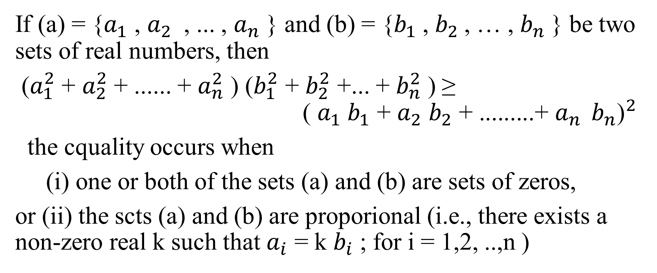
Cauchy Schwarz Inequality
If (a) = {$a_{1}$ , $a_{2}$ , ... , $a_{n}$ } and (b) = {$b_{1}$, $b_{2}$, … , $b_{n}$} be two sets of real numbers, then
($a_{1}^{2}$ + $a_{2}^{2}$ + ...... + $a_{n}^{2}$ ) ($b_{1}^{2}$ + $b_{2}^{2}$ +... + $b_{n}^{2}$ ) ≥ ${ \text{(} a_{1} b_{1}\text{ + }a_{2} b_{2}\text{ + .........+ }a_{n } b_{n}\text{)}}^{2}$
the cquality occurs when
(i) one or both of the sets (a) and (b) are sets of zeros,
or (ii) the scts (a) and (b) are proporional (i.e., there exists a non-zero real k such that $a_{i}$ = k $b_{i}$ ; for i = 1,2, ..,n )

Slide 6
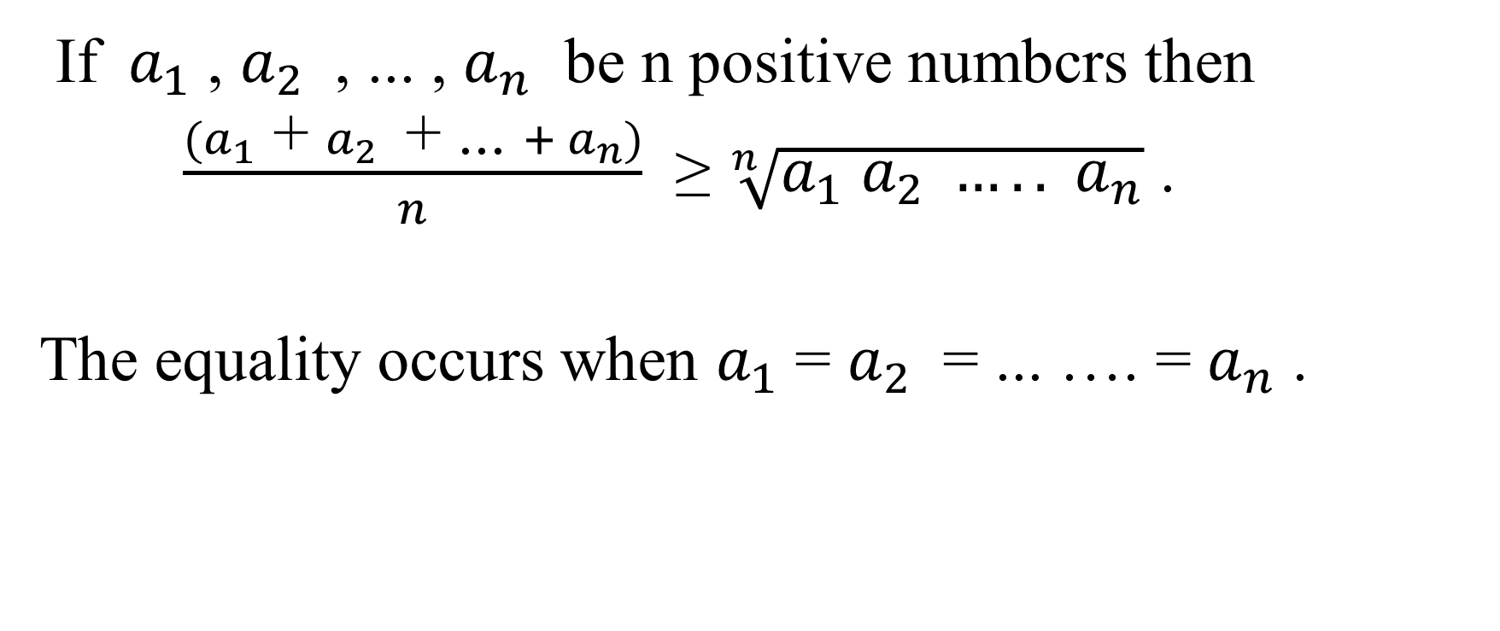
A.M., G.M. Inequality
If $a_{1}$ , $a_{2}$ , ... , $a_{n}$ be n positive numbcrs then
$\frac{(a_{1} \text{+} a_{2} \text{+}\text{ ... }+ a_{n})}{n}$ ≥ $\sqrt[n]{a_{1} a_{2} ….. a_{n}}$ .
The equality occurs when $a_{1}$ = $a_{2}$ = ... …. = $a_{n}$ .

